Slide 1

Project
IBM Company

Slide 2
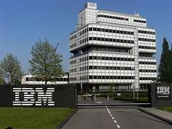
IBM INTRODUCTION
IBM is an abbreviation for International Business Machines. It's also known as Big Blue, and it's one of the largest IT companies in the world. It provides a wide variety of hardware and software to choose from.
Cognitive computing and cloud-based services were added to the company's service offering in 2010. IBM's revenue peaked at $106.9 billion in 2011 but then fell as the company transitioned to new technologies. Total revenue in 2015 was $81.7 billion.

Slide 3
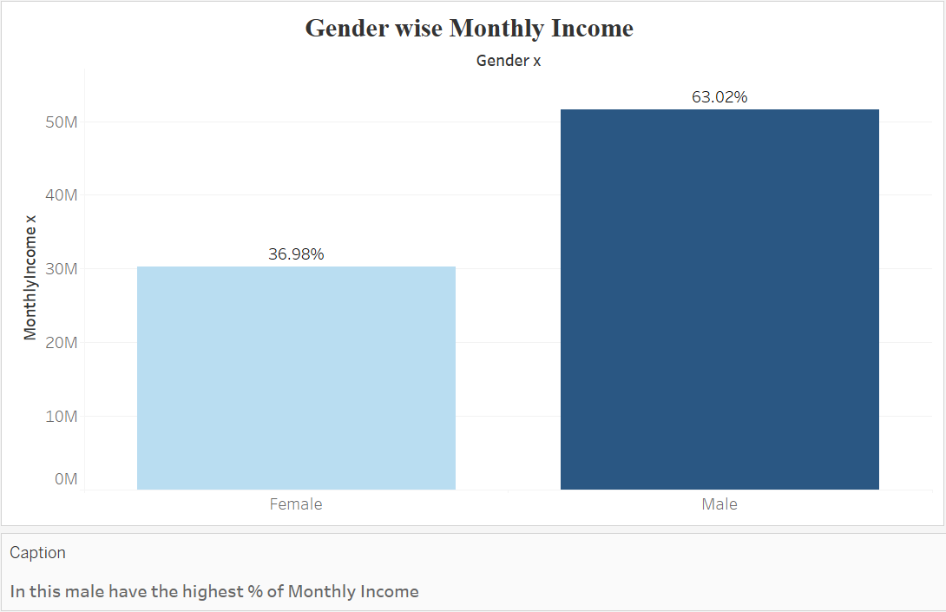
Which Gender have highest Monthly Income.

Slide 4
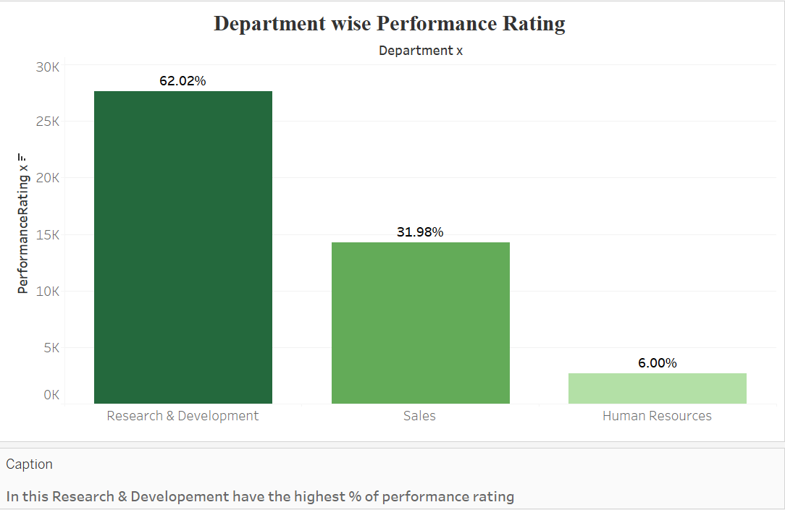
Which Department have the highest percentage of performance rating .

Slide 5
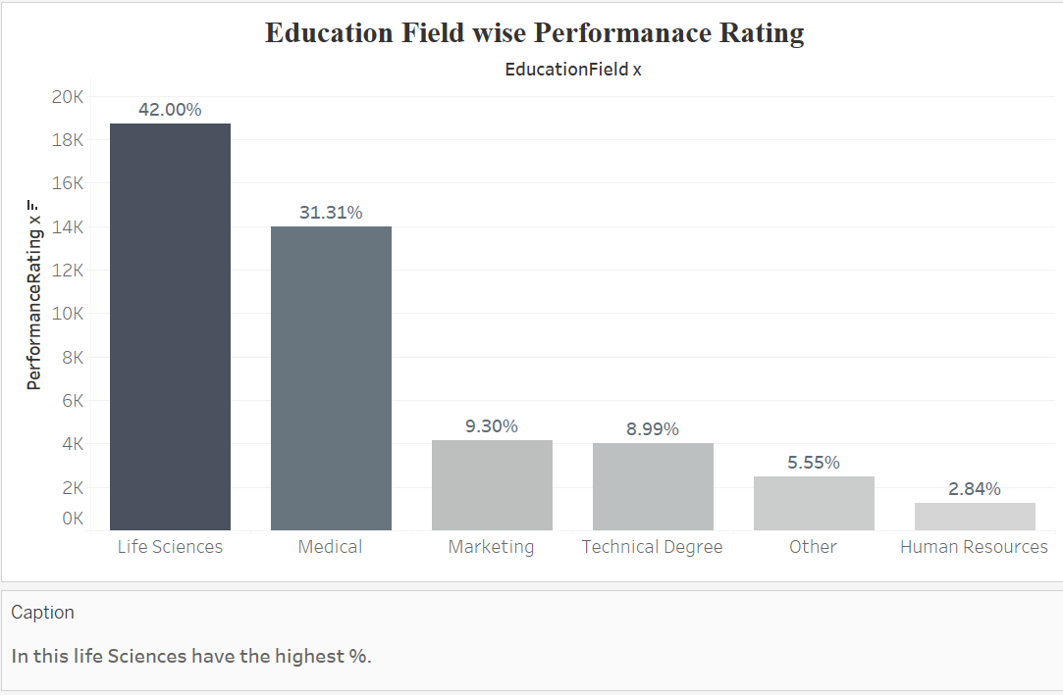
Which Education Field have the highest percentage of performance rating .

Slide 6
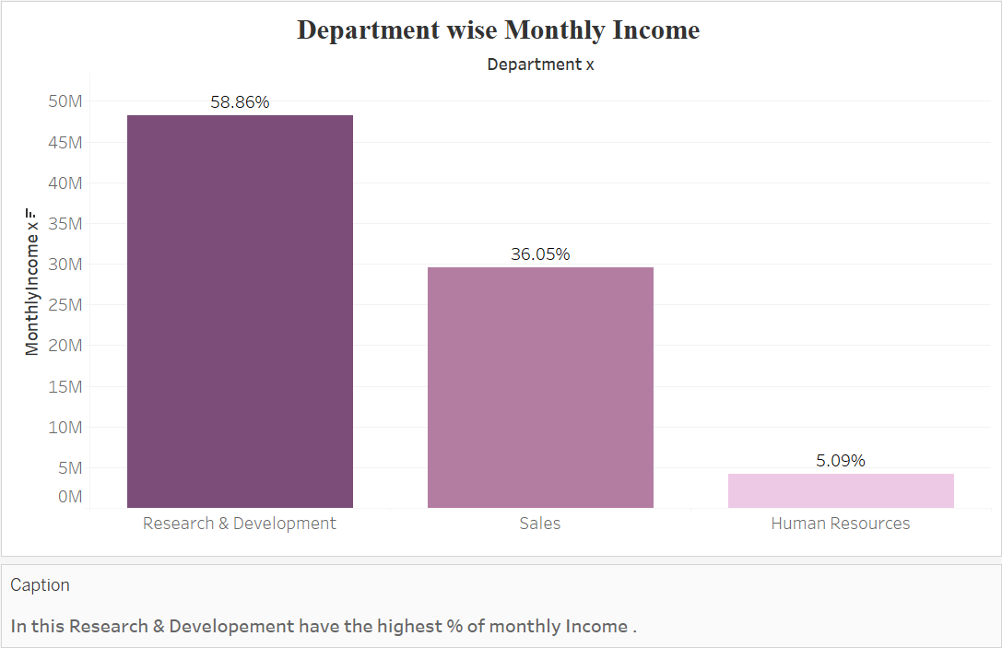
Which Department have the highest percentage of Monthly Income .

Slide 7
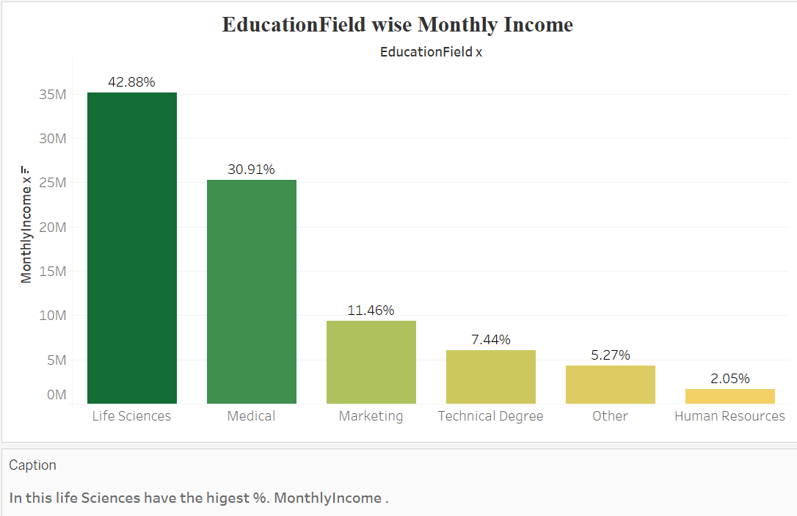
Which Education Field have the highest percentage of Monthly Income.

Slide 8
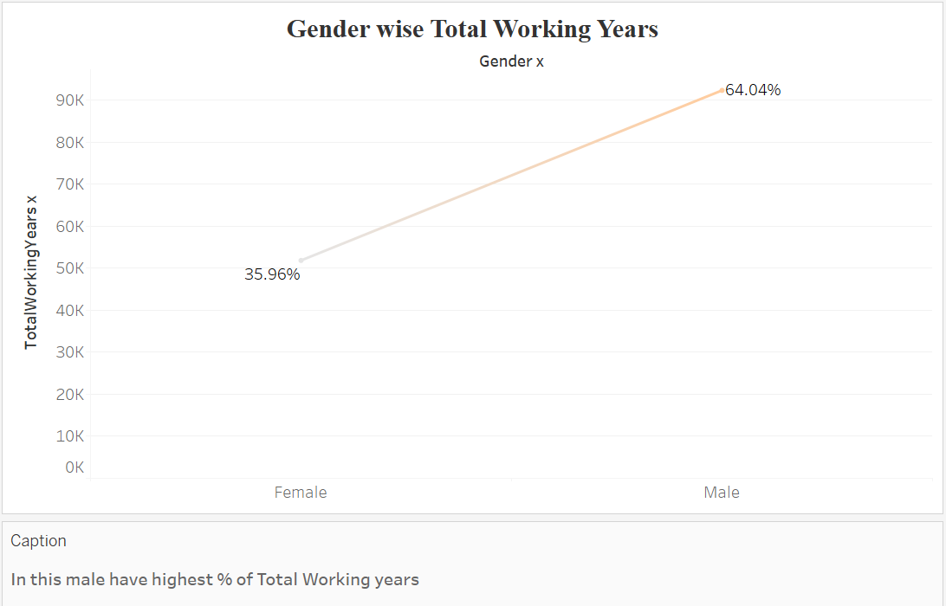
Which Gender have the highest percentage of total working years.

Slide 9
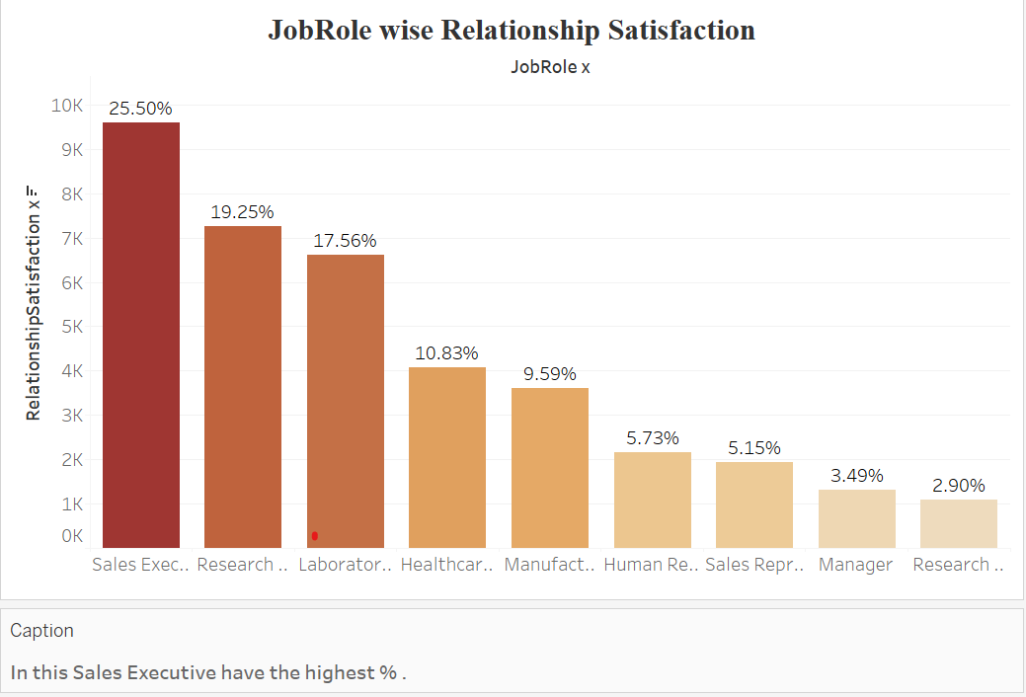
Which job role have the highest relationship satisfaction .

Slide 10
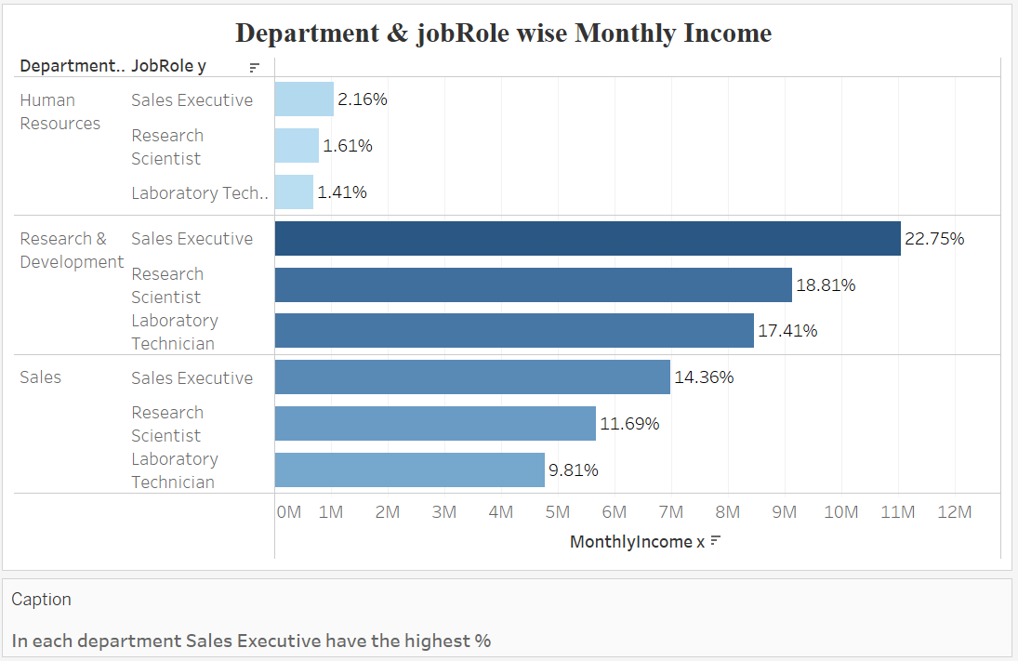
Which Department and job role have the highest percentage of Monthly Income .

Slide 11
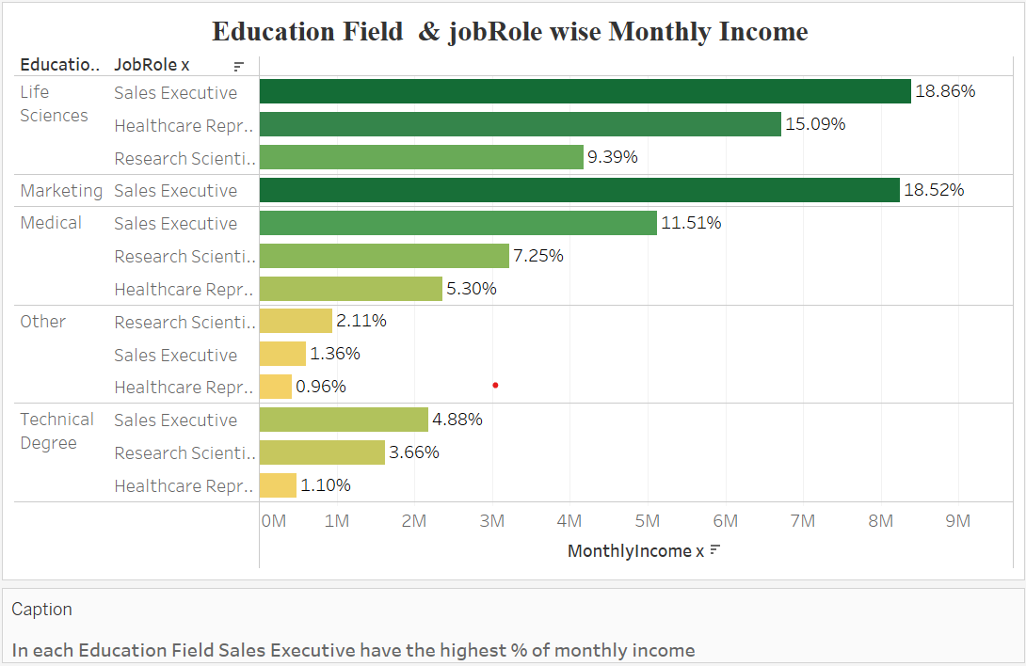
Which Education Field and job role have the highest percentage of Monthly Income.

Slide 12
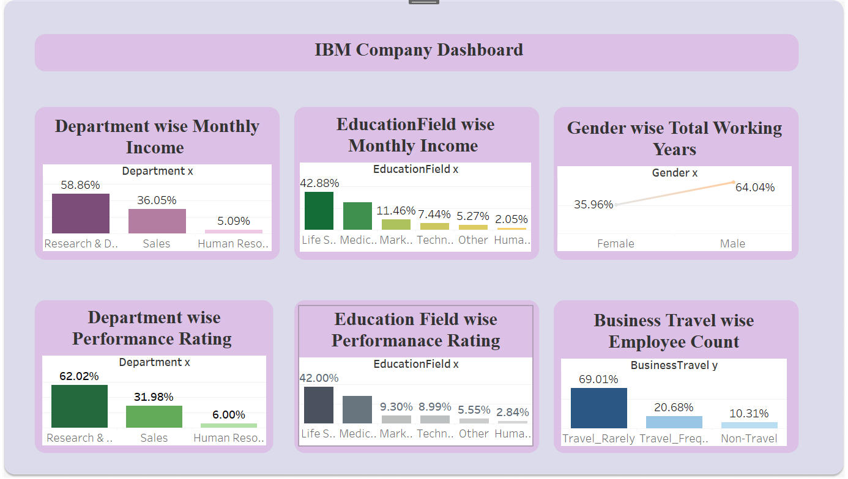

Slide 13
Conclusion
In this male have the highest % of Monthly Income .
In this Research & Development have the highest % of performance rating.
In this life Sciences have the highest %.
In this Research & Development have the highest % of monthly Income .
In this life Sciences have the highest %. Monthly Income .
In this male have highest % of Total Working years,
In this Sales Executive have the highest % .
In this Travel Rarely have the highest % .
In each department Sales Executive have the highest %
In each Education Field Sales Executive have the highest % of monthly income .

Slide 14


